Slide 1
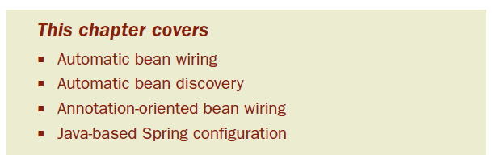
Chapter 3: Minimizing XML configuration in Spring
So far, we’ve seen how to declare beans using the <bean> element and inject <bean> with values using either the <constructor-arg> or <property> element.
Notes:
-That’s all well and good for a small application where you only have a handful of beans. But as your application grows, so will the amount of XML configuration you’ll write.

Slide 2
Fortunately, Spring offers a few tricks to help cut down on the amount of XML configuration required:
Autowiring helps reduce or even eliminate the need for <property> and <constructor-arg> elements by letting Spring automatically figure out how to wire bean dependencies.
Autodiscovery takes autowiring a step further by letting Spring figure out which classes should be configured as Spring beans, reducing the need for the <bean> element.

Slide 3
When used together, autowiring and autodiscovery can dramatically reduce the amount of XML Spring configuration.

Slide 4
3.1 Automatically wiring bean properties
Taking advantage of the obvious wirings, Spring offers autowiring
Rather than explicitly wiring bean properties, why not let Spring sort out those cases when there’s no question about which bean reference should be wired?
Notes:
-”The moon is bright tonight” - That’s because we both reside on the Earth and in that context it’s obvious that I’m talking about Luna, the Earth’s moon
-If I were to say the same thing while we were standing on Jupiter, you’d be justified in asking which of the planet’s 63 natural satellites I had in mind
-If your application context only has one bean of type javax.sql.DataSource, then any bean that needs a DataSource will certainly need that DataSource.

Slide 5
3.1.1 The four kinds of autowiring
byName—Attempts to match all properties of the autowired bean with beans that have the same name (or ID) as the properties.
byType—Attempts to match all properties of the autowired bean with beans whose types are assignable to the properties.
constructor—Tries to match up a constructor of the autowired bean with beans whose types are assignable to the constructor arguments.
autodetect—Attempts to apply constructor autowiring first. If that fails, byType will be tried.

Slide 6
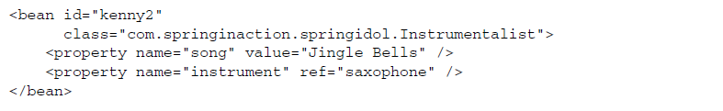
AUTOWIRING BY NAME
In Spring, everything is given a name. Thus bean properties are given names, as are the beans that are wired into those properties.

Slide 7
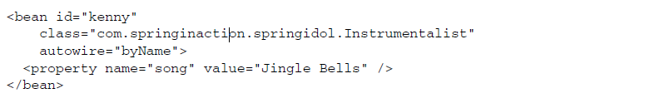
byName autowiring establishes a convention where a property will automatically be wired with a bean of the same name.
In setting the autowire property to byName, you’re telling Spring to consider all properties of kenny and look for beans that are declared with the same names as the properties

Slide 8
Exercise 3-1
Configure eddie to use the byName autowiring specifically for the instrument he will be using(take out the <constructor-arg ref="guitar"/> line).
Run AnnotationConfigTest as Junit Test to confirm the autowiring

Slide 9
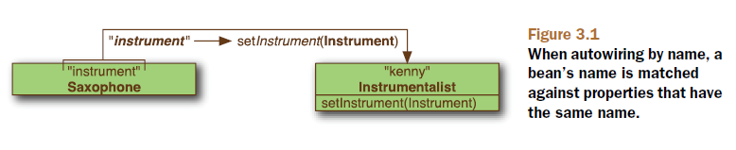
The downside of using byName autowiring is that it assumes that you’ll have a bean whose name is the same as the name of the property of another bean. If multiple Instrumentalist beans are configured to be autowired by name, then all of them will be playing the same instrument.

Slide 10
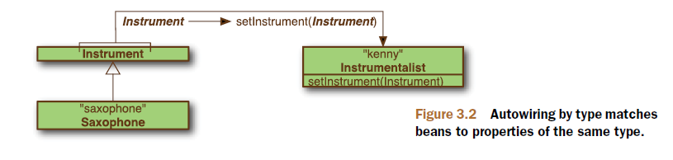
AUTOWIRING BY TYPE
Autowiring using byType works in a similar way to byName, except that instead of considering a property’s name, the property’s type is examined.

Slide 11
What happens if Spring finds more than one bean whose type is assignable to the autowired property?
In such a case, Spring isn’t going to guess which bean to autowire and will instead throw an exception.
To overcome ambiguities with autowiring by type, Spring offers two options:
primary candidate for autowiring
eliminate beans from autowiring candidacy

Slide 12
To identify a primary autowire candidate, you’ll work with the <bean> element’s primary attribute.
If only one autowire candidate has the primary attribute set to true, then that bean will be chosen in favor of the other candidates.
But here’s the weird side of the primary attribute: it defaults to true.

Slide 13
The primary attribute is only useful for identifying a preferred autowire candidate. If you’d rather eliminate some beans from consideration when autowiring, then you can set their autowire-candidate attribute to false

Slide 14
Exercise 3-2
Configure eddie to use the byType autowiring specifically for the instrument he will be using
Run AnnotationConfigTest as Junit Test to confirm the autowiring
Uncomment ‘piano’ bean and run Junit test again to see what happens
Reconfigure to have guitar as the chosen instrument even if both piano and guitar are declared as beans

Slide 15

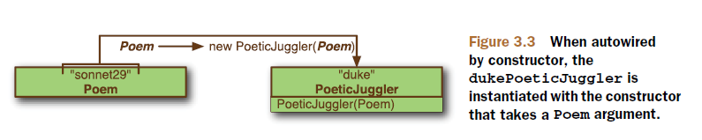
AUTOWIRING CONSTRUCTORS
If your bean is configured using constructor injection, you may choose to put away the <constructor-arg> elements and let Spring automatically choose constructor arguments from beans in the Spring context.

Slide 16
Limitations:
multiple beans that match a constructor’s arguments
if a class has multiple constructors

Slide 17
BEST-FIT AUTOWIRING
If you want to autowire your beans, but you can’t decide which type of autowiring to use, have no fear
You can set the autowire attribute to autodetect to let Spring make the decision for you

Slide 18
When a bean has been configured to autowire by autodetect, Spring will attempt to autowire by constructor first.
If a suitable constructor-to-bean match can’t be found, then Spring will attempt to autowire by type.

Slide 19
Exercise 3-3
Try out constructor autowiring on eddie
Run AnnotationConfigTest as Junit Test to confirm the autowiring
Uncomment ‘piano’ bean and run Junit test again to see what happens

Slide 20
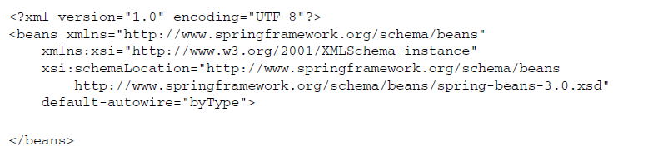
3.1.2 Default autowiring
By default, default-autowire is set to none, indicating that no beans should be autowired unless they’re individually configured for autowiring with the autowire attribute.

Slide 21
Note that default-autowire would be applied to all beans in a given Spring configuration file
Also, just because you’ve defined a default autowiring scheme, that doesn’t mean that you’re stuck with it for all of your beans. You can still override the default on a bean-by-bean basis using the autowire attribute.

Slide 22
Exercise 3-4
Try out default autowiring
Run AnnotationConfigTest as Junit Test to confirm the autowiring

Slide 23
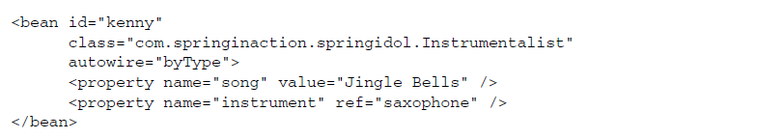
3.1.3 Mixing auto with explicit wiring
Just because you choose to autowire a bean, that doesn’t mean you can’t explicitly wire some properties. You can still use the <property> element on any property just as if you hadn’t set autowire.

Slide 24
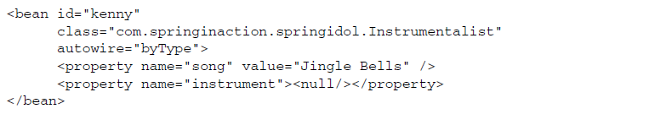
Forcing an autowired property to be null:
One final note on mixed wiring: when using constructor autowiring, you must let Spring wire all of the constructor arguments—you can’t mix <constructor-arg> elements with constructor autowiring.

Slide 25
3.2 Wiring with annotations
Since Spring 2.5, one of the most interesting ways of wiring beans in Spring has been to use annotations to automatically wire bean properties
Allow for more fine-grained autowiring, where you can selectively annotate certain properties for autowiring

Slide 26
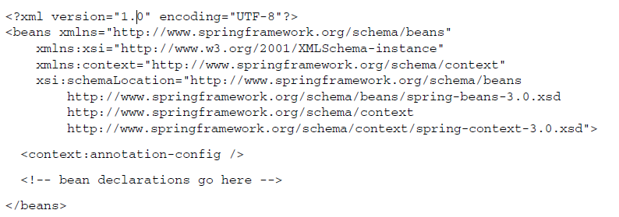
<context:annotation-config> tells Spring that you intend to use annotation-based wiring in Spring.

Slide 27
Spring 3 supports a few different annotations for autowiring:
Spring’s own @Autowired annotation
The @Inject annotation from JSR-330
The @Resource annotation from JSR-250

Slide 28

3.2.1 Using @Autowired
To have Spring autowire the instrument property of the Instrumentalist bean:
When Spring sees that you’ve annotated setInstrument() with @Autowired it’ll try to perform byType autowiring on the method.

Slide 29


What’s especially interesting about @Autowired is that you don’t have to use it with a setter method.
The @Autowired annotation can even be used on constructors:

Slide 30
What’s more, you can directly annotate properties and do away with the setter methods altogether:
As you can see, @Autowired won’t even be thwarted by the private keyword. Even though the instrument property is private, it’ll still be autowired.

Slide 31
Is there no limit to @Autowired’s reach?
there must be exactly one bean that’s applicable for wiring into the @Autowired property or parameter
Fortunately, there’s a way that we can help @Autowired out in those circumstances

Slide 32
OPTIONAL AUTOWIRING
By default, @Autowired has a strong contract, requiring that the thing it annotates is wired. If no bean can be wired into the @Autowired-annotated property or argument, then autowiring fails (with a nasty NoSuchBeanDefinitionException).
But it’s also possible that the property being wired is truly optional and a null value is acceptable.
Notes:
That may be what you want—to have Spring fail early when autowiring goes bad rather than later with a NullPointerException.

Slide 33
Note that the required attribute can be used anywhere @Autowired can be used.
But when used with constructors, only one constructor can be annotated with @Autowired and required set to true. All other @Autowired-annotated constructors must have required set to false.
When multiple constructors are anno- tated with @Autowired, Spring will choose the constructor which has the most arguments that can be satisfied

Slide 34
Exercise 3-5
Try out @Autowire annotation
Configure AnnotationConfigTest by autowiring both eddie and guitar
Configure Instrumentalist to autowire the constructor argument and the instrument property
Run AnnotationConfigTest

Slide 35

QUALIFYING AMBIGUOUS DEPENDENCIES
Not lack of beans but abundance(at least two)
For example, suppose you have two beans that implement Instrument.
To help @Autowired figure out which bean you want, you can accompany it with Spring’s @Qualifier annotation.
Notes:
As shown here, the @Qualifier annotation will try to wire in a bean whose ID matches guitar.

Slide 36
On the surface, it would seem that using @Qualifier is a means of switching @Autowired’s by-type autowiring into explicit by-name wiring
But it’s important to know that @Qualifier is really about narrowing the selection of autowire candidate beans.
In addition to narrowing by a bean’s ID, it’s also possible to narrow by a qualifier that’s applied to a bean itself
Notes:
Here the <qualifier> element qualifies the guitar bean as a stringed instrument.

Slide 37

But instead of specifying the qualifier in XML, you could have also annotated the Guitar class itself with the @Qualifier annotation:

Slide 38
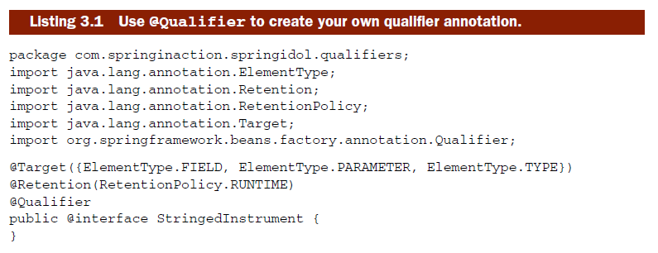
CREATING CUSTOM QUALIFIERS
To create a custom qualifier annotation, all you need to do is to define an annotation that’s itself annotated with @Qualifier.

Slide 39

With the @StringedInstrument annotation defined, you can now use it instead of @Qualifier to annotate Guitar:
Then, you can qualify the @Autowiredinstrument property with @StringedInstrument:

Slide 40
When Spring tries to autowire the instrument property, it’ll narrow the selection of all Instrument beans down to just those that are annotated with @StringedInstrument.
If there’s more than one @StringedInstrument-annotated bean, then you’ll need to provide further qualification to narrow it down.
For example, suppose that in addition to the Guitar bean, you also have a HammeredDulcimer bean which is also anno- tated with @StringedInstrument.

Slide 41
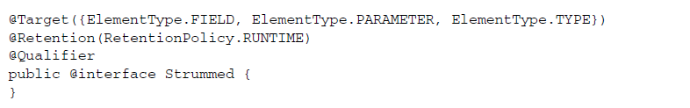

If the Guitar class is the only class annotated with @Strummed and @StringedInstrument, then it’ll be the one injected into instrument.

Slide 42
Spring’s @Autowired annotation is one way to cut down on the amount of Spring configuration XML.
But it does create a Spring-specific dependency within the classes that use it (even if that dependency is just an annotation).
Fortunately, Spring also supports a standard Java alternative to @Autowired.

Slide 43
3.2.2 Applying standards-based autowiring with @Inject
In an effort to unify the programming model among the various dependency injection frameworks, the Java Community Process recently published the Dependency Injection for Java specification.
The centerpiece of JSR-330 is the @Inject annotation. This annotation is an almost complete drop-in replacement for Spring’s @Autowired annotation.
Notes:
Known in the Java Community Process as JSR-330 or more commonly as at inject, this specification brings a common dependency injection model to Java. As of Spring 3, Spring supports the at inject model.2

Slide 44
Just like @Autowired, @Inject can be used to autowire properties, methods, and constructors.
Unlike @Autowired, @Inject doesn’t have a required attribute. Therefore, @Inject-annotated dependencies are expected to be fulfilled, failing with an exception if they’re not.

Slide 45

JSR-330 has another trick up its sleeve in addition to the @Inject annotation. Rather than inject a reference directly, you could ask @Inject to inject a Provider. The Provider interface enables, among other things, lazy injection of bean references and injection of multiple instances of a bean.

Slide 46
QUALIFYING @INJECTED PROPERTIES
@Inject’s answer to the @Qualifier annotation is the @Named annotation.
Notes:
The key difference between Spring’s @Qualifier and JSR-330’s @Named is one of semantics. Whereas @Qualifier helps narrow the selection of matching beans (using the bean’s ID by default), @Named specifically identifies a selected bean by its ID.

Slide 47
CREATING CUSTOM JSR-330 QUALIFIERS
As it turns out, JSR-330 has its own @Qualifier annotation in the javax.inject package.
Unlike Spring’s @Qualifier, the JSR-330 version isn’t intended to be used on its own. Instead, you’re expected to use it to create custom qualifier annotations, much as we did with Spring’s @Qualifier.

Slide 48
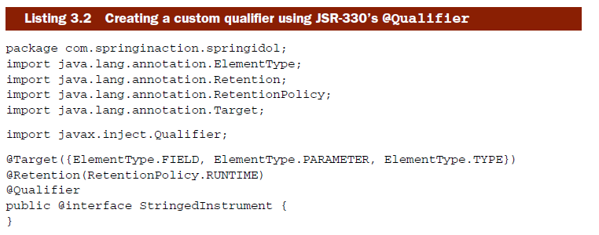

Slide 49
Exercise 3-6
Goal: AnnotationConfigTest.java Junit Test should pass
Notes:
Annotation-based autowiring is great for wiring bean references and reducing <property> elements in our Spring XML configuration. But can annotations be used to wire values into String and other primitive values?

Slide 50
3.2.3 Using expressions with annotation injection
As long as you’re using annotations to autowire bean references into your Spring beans, you may want to also use annotations to wire simpler values.
Spring 3.0 introduced @Value, a new wiring annotation that lets you wire primitive values such as int, boolean, and String using annotations.
Notes:
The @Value annotation is simple to use but, as you’ll soon see, is also powerful. To use it, annotate a property, method, or method parameter with @Value and pass in a String expression to be wired into the property.

Slide 51
Wiring hardcoded values using @Value is interesting, but not all that necessary. If you’re hardcoding the values in Java code, then why not disregard @Value altogether and just hardcode the value directly on the property? @Value seems like extra baggage in that case.
As it turns out, simple values aren’t where @Value shines. Instead, @Value finds its power with SpEL expressions.
Notes:
Now @Value shows its stuff. It’s not just a courier of static values—it’s an effective, annotation-driven method of wiring dynamically evaluated SpEL expressions.

Slide 52
As you can see, autowiring is a powerful technique. Letting Spring automatically figure out how to wire beans together can help you reduce the amount of XML configuration in your application.
What’s more, autowiring can take decoupling to a whole new level by decoupling bean declarations from each other.
Notes:
Speaking of rising to new levels, let’s now look at bean autodiscovery to see how we can rely on Spring to not only wire beans together, but also automatically figure out which beans should be registered in a Spring context in the first place.

Slide 53
3.3 Automatically discovering beans
<context:annotation-config> - telling Spring that you wanted it to honor a certain set of annotations in the beans that you declared and to use those beans to guide bean wiring
Necessity of explicitly declare beans using <bean>
<context:component-scan> element does everything that <context:annotation-config> does, plus it configures Spring to automatically discover beans and declare them for you

Slide 54
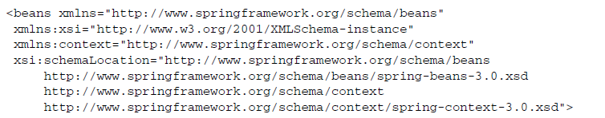
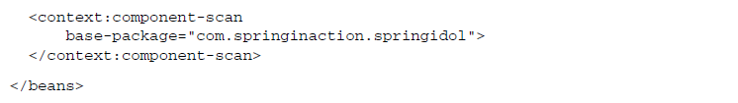
The <context:component-scan> element works by scanning a package and all of its subpackages, looking for classes that could be automatically registered as beans in the Spring container. The base-package attribute tells <context:component-scan> the package to start its scan from.
Notes:
So, how does <context:component-scan> know which classes to register as Spring beans?

Slide 55
3.3.1 Annotating beans for autodiscovery
By default, <context:component-scan> looks for classes that are annotated with one of a handful of special stereotype annotations:
@Component—A general-purpose stereotype annotation indicating that the class is a Spring component
@Controller—Indicates that the class defines a Spring MVC controller
@Repository—Indicates that the class defines a data repository
@Service—Indicates that the class defines a service
Any custom annotation that is itself annotated with @Component

Slide 56
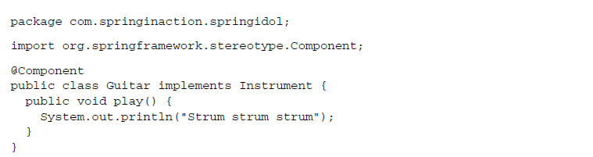
When Spring scans the com.springinaction.springidol package, it’ll find that Guitar is annotated with @Component and will automatically register it in Spring.
By default, the bean’s ID will be generated by camel-casing the class name. In the case of Guitar that means that the bean ID will be guitar.

Slide 57


In this case, we’ve specified a bean ID as a parameter to @Component. The bean ID would’ve been “instrumentalist,” but to keep it consistent with the previous examples, we’ve explicitly named it eddie.
Notes:
Annotation-based autodiscovery is just one option available when using <context: component-scan>. Let’s see how to configure <context:component-scan> to look for bean candidates using other means.

Slide 58
Exercise 3-7
Convert the project springidol-autodiscovery-exercise from ‘annotation-cofig’ to ‘autodiscovery’
Take out <context:annotation-config /> and all <bean> declarations from spring-idol.xml and replace with autodiscovery.
Goal: AnnotationConfigTest should pass
Notes:
Annotation-based autowiring is great for wiring bean references and reducing <property> elements in our Spring XML configuration. But can annotations be used to wire values into String and other primitive values?

Slide 59
3.3.2 Filtering component-scans
As it turns out, <context:component-scan> is flexible with regard to how it scans for bean candidates.
By adding <context:include-filter> and/or <context:exclude-filter> subelements to <context:component-scan>, you can tweak component- scanning behavior to your heart’s content.

Slide 60
To demonstrate component-scan filtering, consider what it would take to have <context:component-scan> automatically register all classes that are implementations of Instrument using the annotation-based strategy.
Notes:
We’d have to visit the source code for each of the Instrument implementations and annotate them with @Component (or one of the other stereotype annotations). At the least, that’d be inconvenient. And if we were working with a third-party implementation of Instrument we may not even have access to the source code to be able to add that annotation.

Slide 61
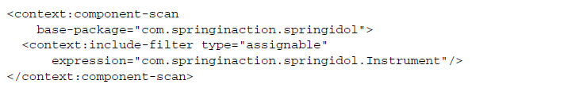
So, instead of relying on annotation-based component scanning, you can ask <context:component-scan> to automatically register all classes that are assignable to Instrument by adding an include filter
The type and the expression attributes of <context:include-filter> work together to define a component-scanning strategy.
Notes:
In this case, we’re asking for all classes that are assignable to Instrument to be automatically registered as Spring beans.

Slide 62
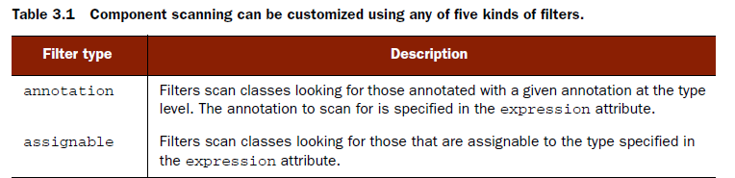
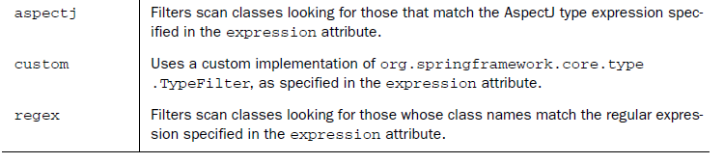

Slide 63
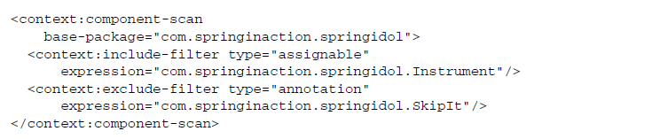
Just as <context:include-filter> can be used to tell <context:component-scan> what it should register as beans, you can use <context:exclude-filter> to tell it what not to register.
Notes:
When it comes to filtering <context:component-scan>, the possibilities are virtually endless. But you’ll find that the default annotation-based strategy is the most commonly used. And it’ll be the one you’ll see most often throughout this book.

Slide 64
3.4 Using Spring’s Java-based configuration
Believe it or not, not all developers are fans of XML. In fact, some are card-carrying members of the He-Man XML Haters Club.
Now you have the option of configuring a Spring application with almost no XML, using pure Java.
even if you don’t hate XML, you may want to try out Spring’s Java-based configuration because, as you’ll soon see, the Java-based configuration knows a few tricks that its XML counterpart doesn’t.
Notes:
They’d love nothing more than to rid the world of the dreaded angle bracket. Spring’s long history of using XML in its configuration has turned off a few of those who oppose XML.

Slide 65

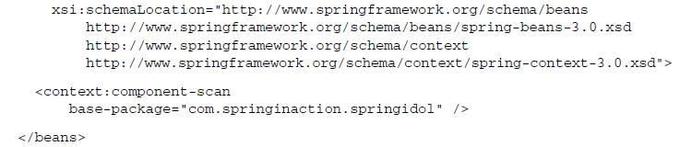
3.4.1 Setting up for Java-based configuration

Slide 66
We’ve already seen how <context:component-scan> automatically registers beans that are annotated with certain stereotype annotations. But it also automatically loads in Java-based configuration classes that are annotated with @Configuration.
In this case, the base-package attribute tells Spring to look in com.springinaction.spring- idol to find classes that are annotated with @Configuration.

Slide 67

3.4.2 Defining a configuration class
When we first started looking at Spring’s XML-based configuration, I showed you a snippet of XML with the <beans> element from Spring’s beans namespace at its root.
Java-based equivalent:
Notes:
The @Configuration annotation serves as a clue to Spring that this class will contain one or more Spring bean declarations. Those bean declarations are just methods that are annotated with @Bean.

Slide 68

3.4.3 Declaring a simple bean
In the previous chapter, we used Spring’s <bean> element to declare a Juggler bean whose ID was duke.
The @Bean tells Spring that this method will return an object that should be registered as a bean in the Spring application context.

Slide 69
The bean will get its ID from the method name.
Everything that happens in the method ultimately leads to the creation of the bean.
In Spring’s Java-based configuration, there are no String attributes. Both the bean’s ID and its type are expressed as part of a method signature. The actual creation of the bean is defined in the method body.
Because it’s all Java, you gain some benefit in terms of compile-time checking to ensure that your bean’s type is a real type and that its ID is unique.
Notes:
In Spring’s Java-based configuration, there are no String attributes. Both the bean’s ID and its type are expressed as part of a method signature.

Slide 70
3.4.4 Injecting with Spring’s Java-based configuration
If declaring beans with Spring’s Java-based configuration is nothing more than writing a method that returns an instance of a class, then how does dependency injection work in Java-based configuration?

Slide 71


Wiring simple values is straightforward enough. What about wiring in references to other beans?

Slide 72
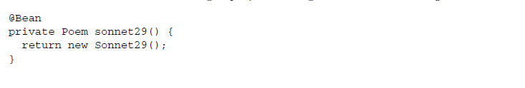

Wiring in another bean is a simple matter of referring to that bean’s method. But don’t let the simplicity fool you. More is going on here than meets the eye.

Slide 73
By annotating the sonnet29() method with @Bean, we’re telling Spring that we want that method to define a bean to be registered in the Spring application context.
Then, whenever we refer to that method in another bean declaration method, Spring will intercept the call to the method and try to find the bean in its context instead of letting the method create a new instance.

Slide 74
XML-based disadvantages:
Type-safety
XML is verbose, so configuration files get big. It’s a good thing to split them up.
Regarding splitting the configuration up: it’s not possible to navigate between different XML-files.
It’s really hard to find XML configuration files in jars on the classpath, and it’s even harder to detect references in those files.
Some of those disadvantages may be covered up somehow when you’ve got the right tooling, but often you cannot choose your IDE. And not everything can be covered up.

Slide 75
Java-based config:
Tooling
- type-safety check by compiling - code completion - refactoring support - support for finding references in the workspace (even on jars in the classpath)
Language
-I like Java, so why should I use different language construct for configurations? It feels really natural not to switch between Java and XML anymore. And of course, you can program anything you want directly in Java when creating Spring beans, like calling init-methods or static factory methods. No need for complicated ways to express that in XML.

Slide 76
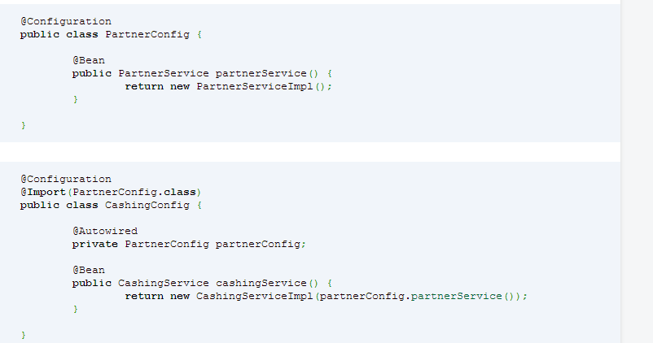
Patterns
-Navigable configurations

Slide 77
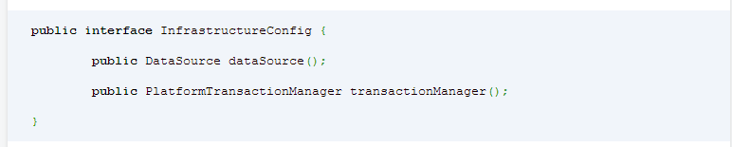
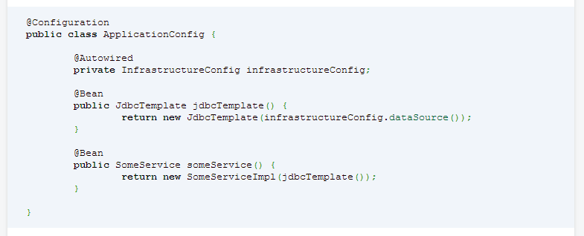
-Abstract dependency definitions

Slide 78
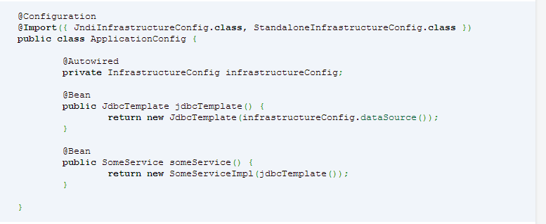
-Multiple imports and profiles

Slide 79
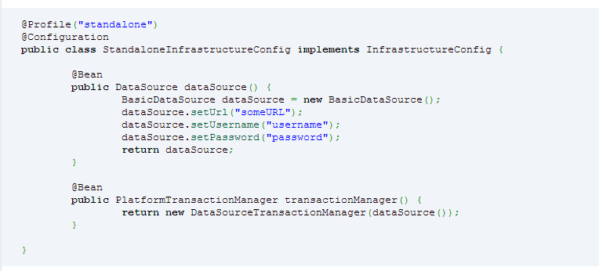
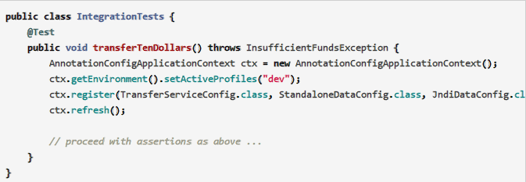

Slide 80
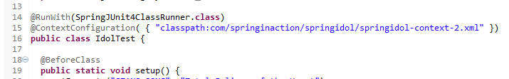
Exercise 3-1
Open project springidol-javaconfig
Run IdolTest.java – this should show up as success in Junit test console
Now transform the project into Spring’s Java-based configuration by using the provided springidol-context-2.xml
Without changing any other code from IdolTest.java(except the above), your goal is to run the Junit Test with a success status(green)

Slide 81
-End of Chapter 3-

